Slide 1
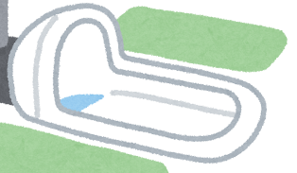
校園(?)
故事

Slide 2

1.目標
Notes:
https://www.istockphoto.com/photo/tired-woman-sleeping-on-the-table-in-the-kitchen-at-breakfast-trying-to-drink-gm1059134652-283086936?irclickid=TIlUS7RyQxyKTi9Wv2T0hXFsUkCWOmSHYVo0Wg0&irgwc=1&cid=IS&utm_medium=affiliate&utm_source=Curly+Eskimo&clickid=TIlUS7RyQxyKTi9Wv2T0hXFsUkCWOmSHYVo0Wg0&utm_term=stockvault&utm_content=1852840&irpid=13749

Slide 3

2.阻礙
Notes:
https://www.shutterstock.com/zh/image-photo/male-female-distress-having-go-restroom-1882909777?id=1882909777&irclickid=UedWw9RstxyKU%3AeXXj1h%3AUdCUkCWOgVnYVo0Wg0&irgwc=1&pl=13749-42119&utm_campaign=Curly%20Eskimo&utm_content=42119&utm_medium=Affiliate&utm_source=13749&utm_term=photo-search-top

Slide 4

3.努力
Notes:
https://www.stockvault.net/photo/231058/confused-character-means-bewildered-puzzled-or-perplexed

Slide 5

4.結果
Notes:
https://www.stockvault.net/photo/174805/the-road-to-success

Slide 6

5.意外
Notes:
https://www.istockphoto.com/photo/shot-of-a-unrecognizable-woman-sitting-on-a-sofa-and-feeling-anxious-gm1388115341-445847443?irclickid=TIlUS7RyQxyKTi9Wv2T0hXFsUkCWOlXWYVo0Wg0&irgwc=1&cid=IS&utm_medium=affiliate&utm_source=Curly+Eskimo&clickid=TIlUS7RyQxyKTi9Wv2T0hXFsUkCWOlXWYVo0Wg0&utm_term=stockvault&utm_content=1852840&irpid=13749

Slide 7
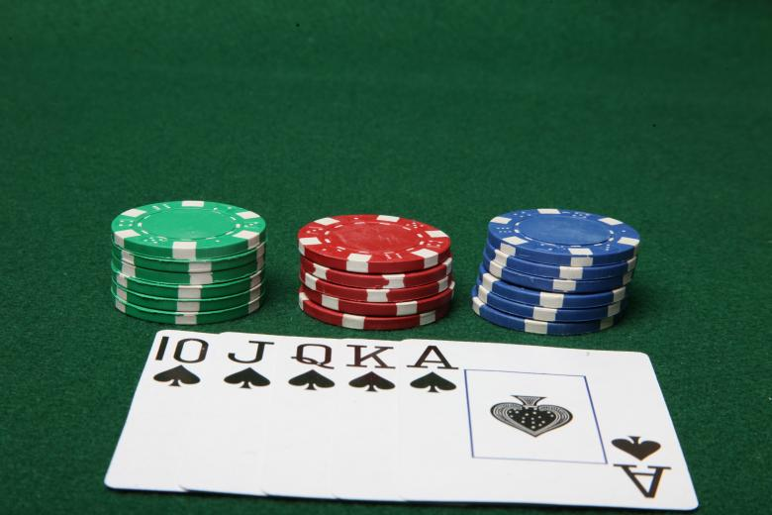
6.轉彎
Notes:
https://www.stockvault.net/photo/149107/royal-flush-with-poker-chips

Slide 8

7.結局
Notes:
https://www.istockphoto.com/photo/creating-ideas-in-team-gm1467799746-499496320?irclickid=TIlUS7RyQxyKTi9Wv2T0hXFsUkCWOiSvYVo0Wg0&irgwc=1&cid=IS&utm_medium=affiliate&utm_source=Curly+Eskimo&clickid=TIlUS7RyQxyKTi9Wv2T0hXFsUkCWOiSvYVo0Wg0&utm_term=stockvault&utm_content=1852840&irpid=13749

Slide 9
感
謝
聽
聆

